Slide 1


EAST WEST INSTITUTE OF TECHNOLOGY DEPARTMENT OF ARTIFICIAL INTELLIGENCE AND DATA SCIENCE INTERNSHIP PRESENTATION ON VEHICLE COUNTING SYSTEM USING
MACHINE LEARNING
Presented By
Purnima R (1EW21AD034)
INTERNAL GUIDE
Mrs. Trupti G N
Asst. Prof
Dept. of ISE
EXTERNAL GUIDE
Mr. Mallikarjun Kumbara
Trainer, Take It Smart
Pvt ltd

Slide 2
TABLE OF CONTENTS
Abstract
Introduction
Company Profile
Proposed System
Implementation
Results
Conclusion
Applications
References

Slide 3
ABSTRACT
Machine learning can be used to detect and classify objects in images and videos. With the rapid development of intelligent video analysis, traffic monitoring has become a key technique for collecting information about traffic conditions. Using the traditional sensors such as loop detectors, ultrasonic sensors may cause damage to the road surface. Surveillance video cameras are commonly used sensors in the traffic monitoring, which can provide video stream for vehicle detection and counting. Vehicle counting process provides appropriate information about traffic flow, vehicle crash occurrences and traffic during the peak times in roadways by using the technique digital image processing methods. We can use computer vision to detect different types of vehicles in a video or real-time via a camera. This project addresses vehicle detection and counting system using opencv and performs morphological operations Vehicle detection and tracking finds its applications in traffic control, car tracking, creating parking sensors & so on.

Slide 4
INTRODUCTION
Vehicle counting is a computer vision based solution that automates the traffic monitoring by providing information about number of vehicle passing through certain point/tolls ,analyzing traffic density.
Due to increase in the demands for the smart cities and numerous increase in vehicle ,it is difficult to keep track of vehicle data. By implementing the above system it makes the individual work easy by maintaining the constant track of vehicle data.
In urban areas, vehicle detection and counting in highway monitoring video scenes plays significant role in intelligent traffic management and control of the highway.

Slide 5
COMPANY PROFILE
TAKE IT SMART(OPC)PVT.LTD is an Indian based engineering and Software Company headquartered in Bangalore, Karnataka, India. It is both product and service oriented software company.
The company initiates industry oriented internship program especially for Technical students by providing opportunity to learn and work along as an intern.
Take it Smart Pvt Ltd is best place for carrying out internships for all students. The Best internships are available on latest Technologies like Machine Learning and Python, Web Development, Embedded System and IOT.

Slide 6
PROPOSED SYSTEM
The method proposed here detects and counts number of vehicles. Vehicle counting software focuses on keeping track of the number and type of vehicles that enter and leave through a particular route for accurate monitoring of traffic from a real time video.
We use modules such as opencv, numpy, pyttsx3 that are responsible for real-time image processing.
The System uses an existing video sequence. The Recorded Video data or real time video data is required as input. Then it is divided into frames.
The morphological operations are applied such as background subtraction, Gaussian blur, thresholding, dilation in order to get preprocessed image that is carried for detection process.
After detecting the moving vehicles, Whenever the vehicle crosses the line drawn at region of interest, counter is incremented by 1 indicating the vehicle is been counted.

Slide 7
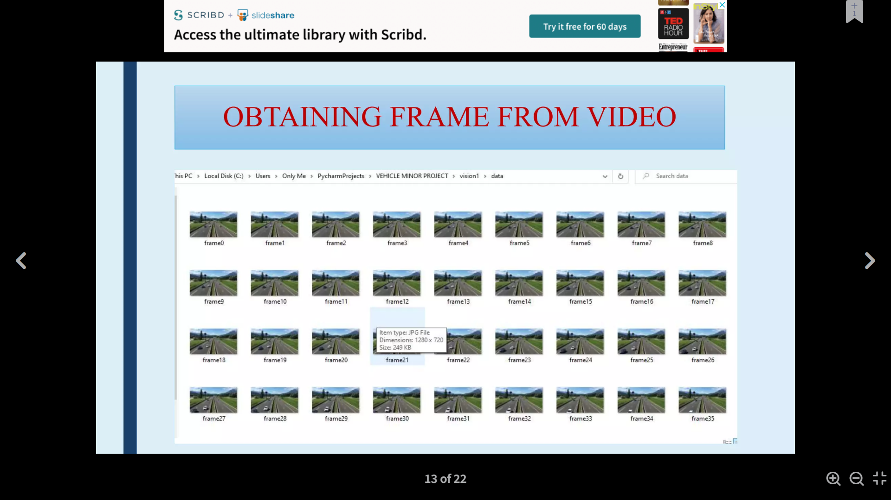
PREPROCESSING
The video frames captured by the surveillance cameras are used as input for counting.
Then it is divided into multiple frames.
Obtaining frames from video

Slide 8
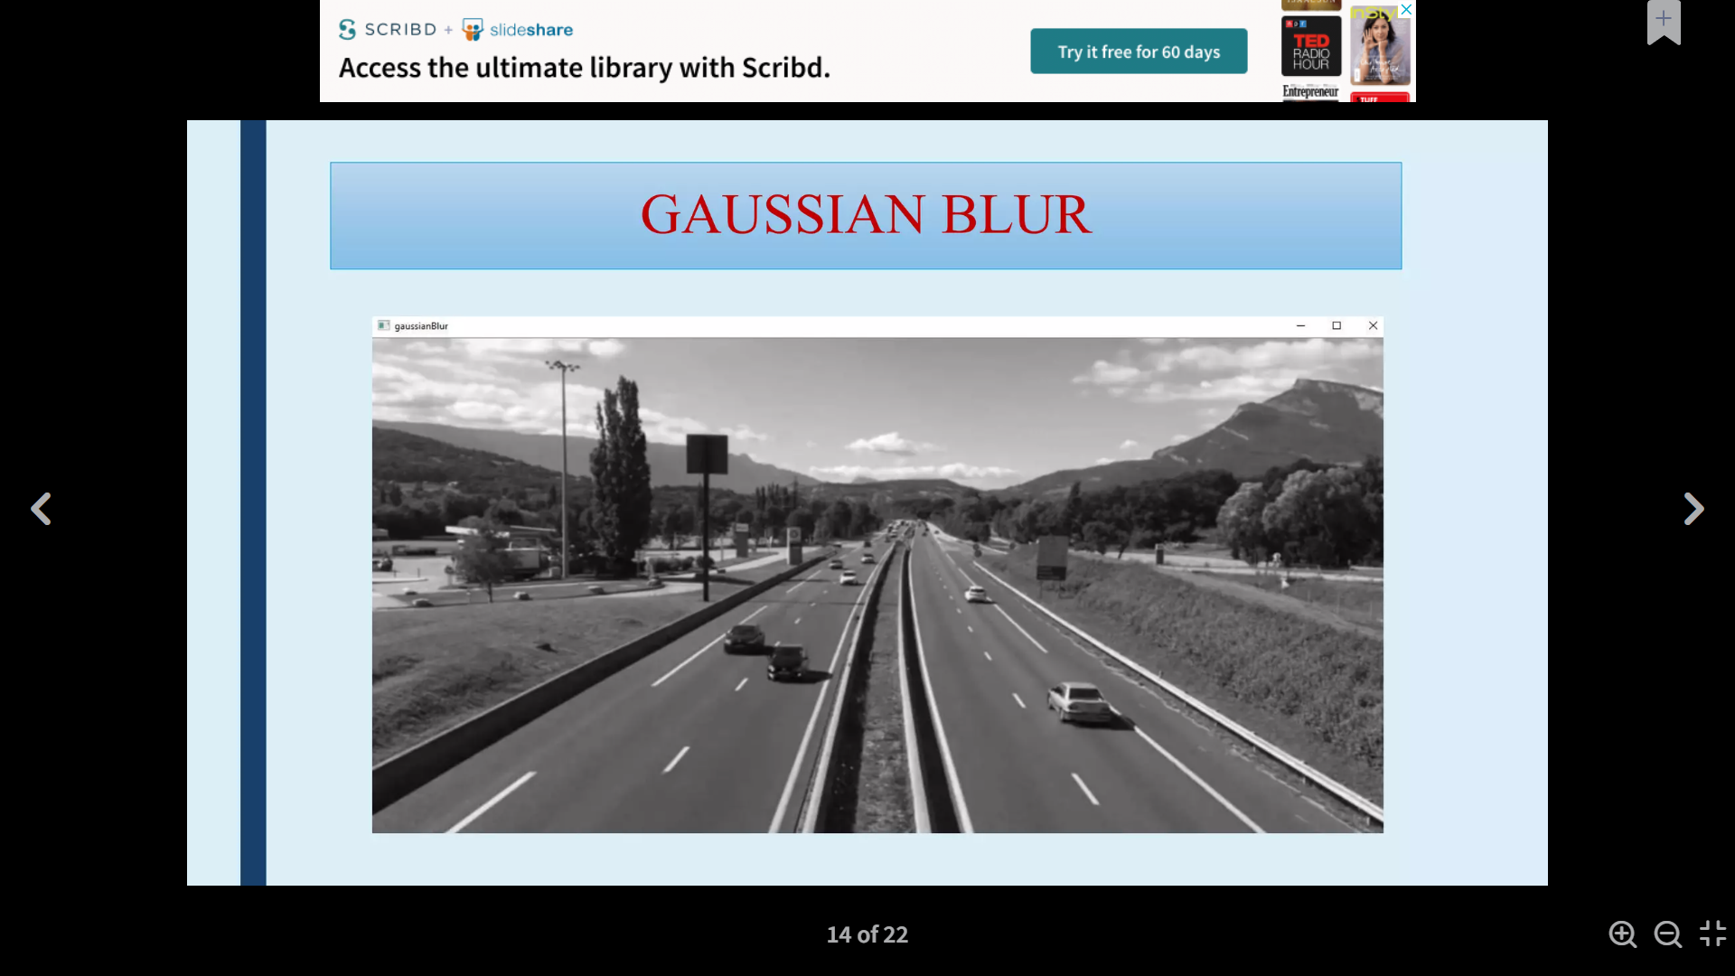
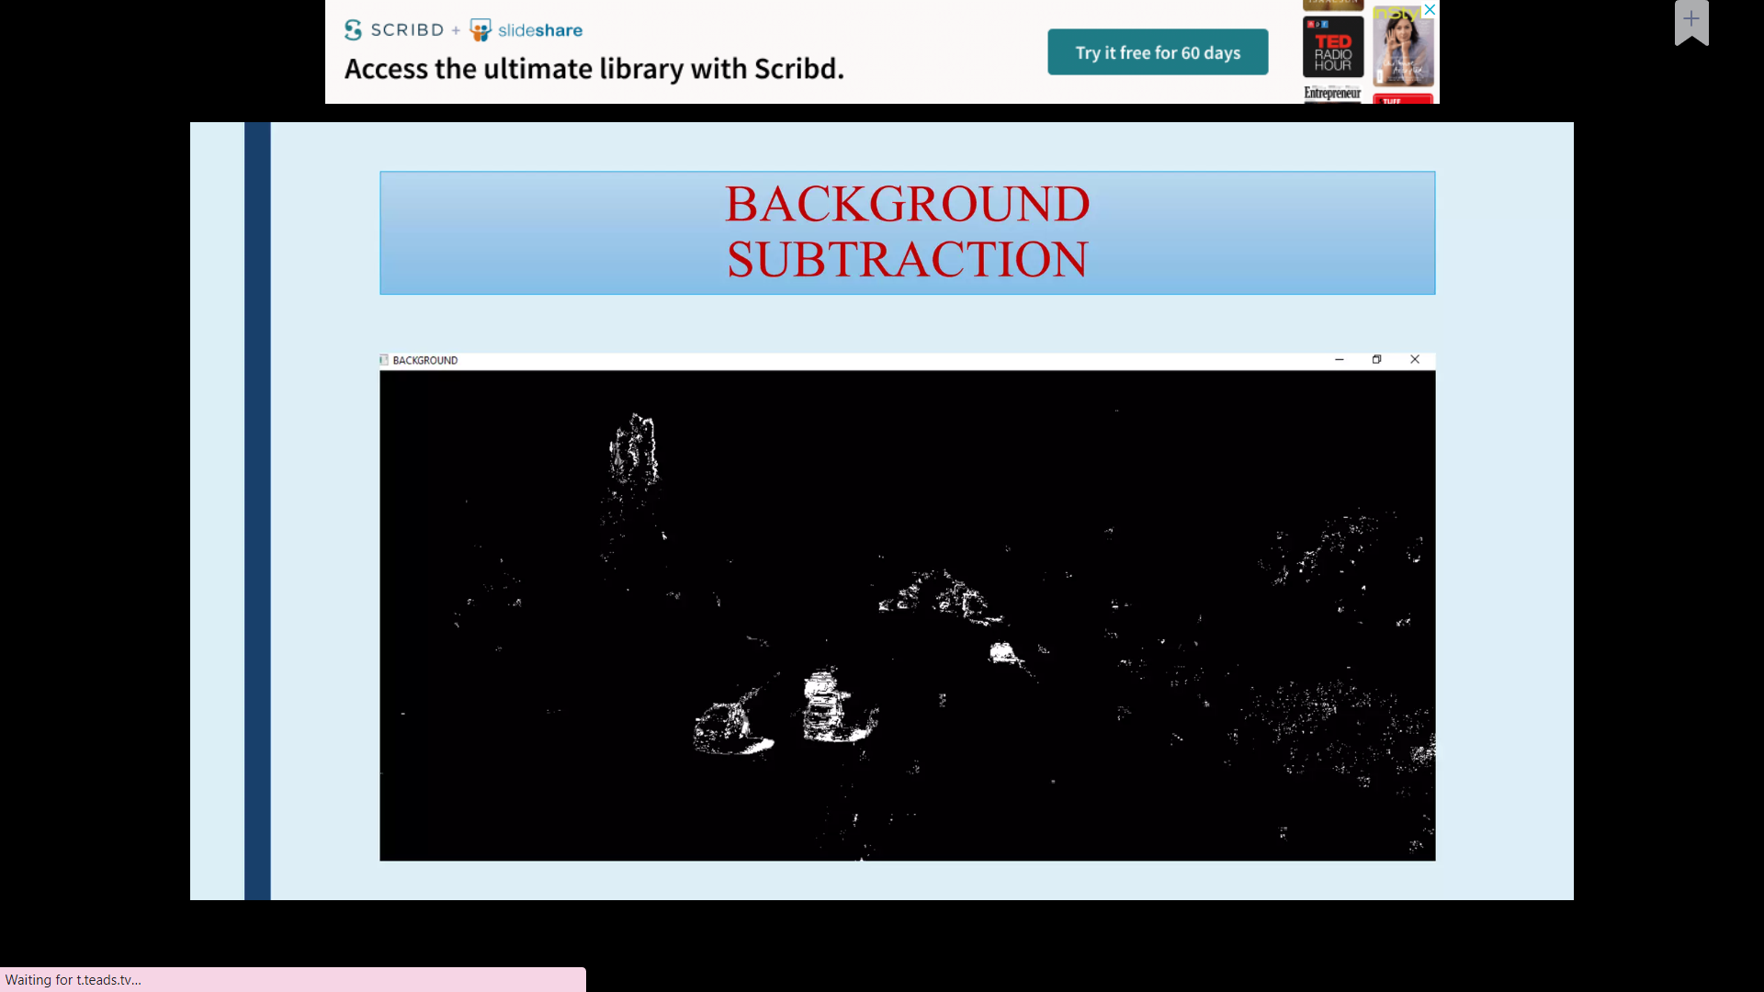
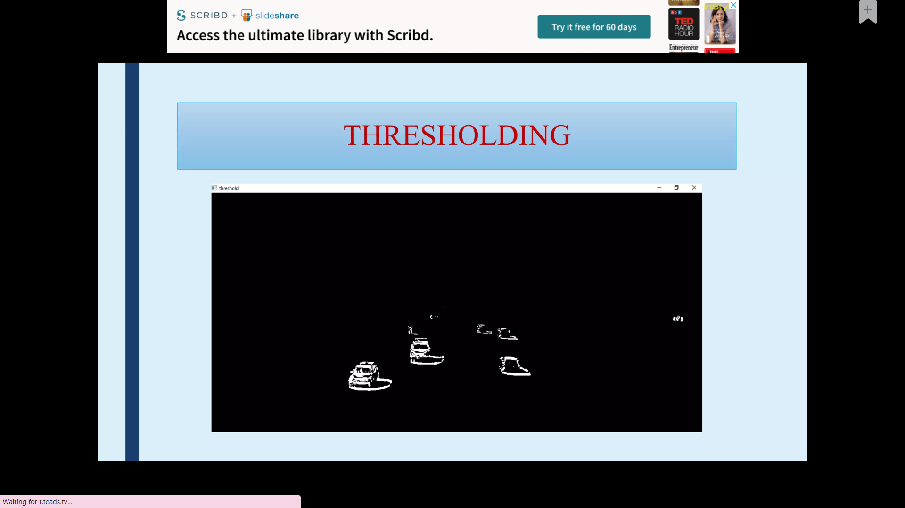
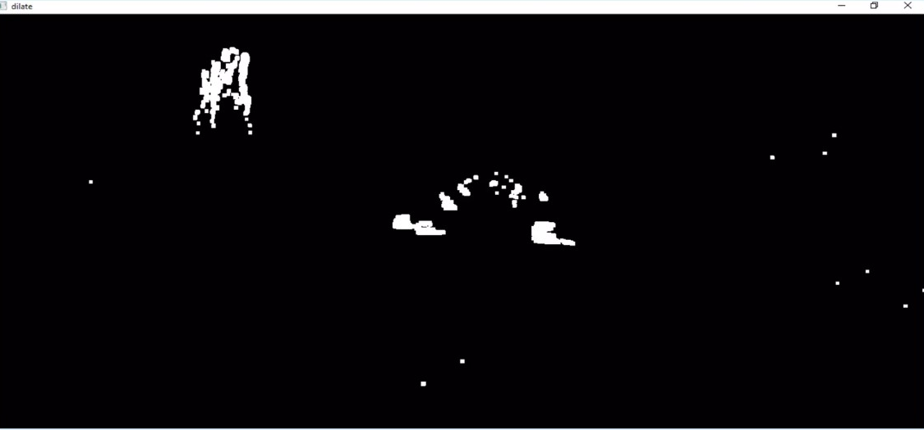
MORPHOLOGICAL OPERATIONS
BACKGROUND SUBTRACTOR
GAUSSIAN BLUR
THRESHOLD
DILATION

Slide 9
IMPLEMENTATION OF FLOWCHART

Slide 10
INPUT DETECTED ADDED TO FRAME LIST
DETECTION OF VEHICLE
Vehicles are detected using bounding boxes around the vehicle. To achieve detection we have used virtual detector to detect the vehicles.After
applying morphological operation on theimages ,the frames will be ready for the detection.
The objects that are detected will added to the frame list and looks for the next further frames available
CHECKS FOR NEXT FRAME
VEHICLE COUNTING SYSTEM
INCREMENT
THE COUNTER
UPDATE VEHICLE
Only the vehicles entering the region of interest are detected and counted. Later the counter will be updated
Firstly the line is drawn as a region of interest inside the frame. After detecting the moving vehicles, their position and centroid are detected. Whenever the vehicle crosses the line drawn, counter is incremented by 1.

Slide 11
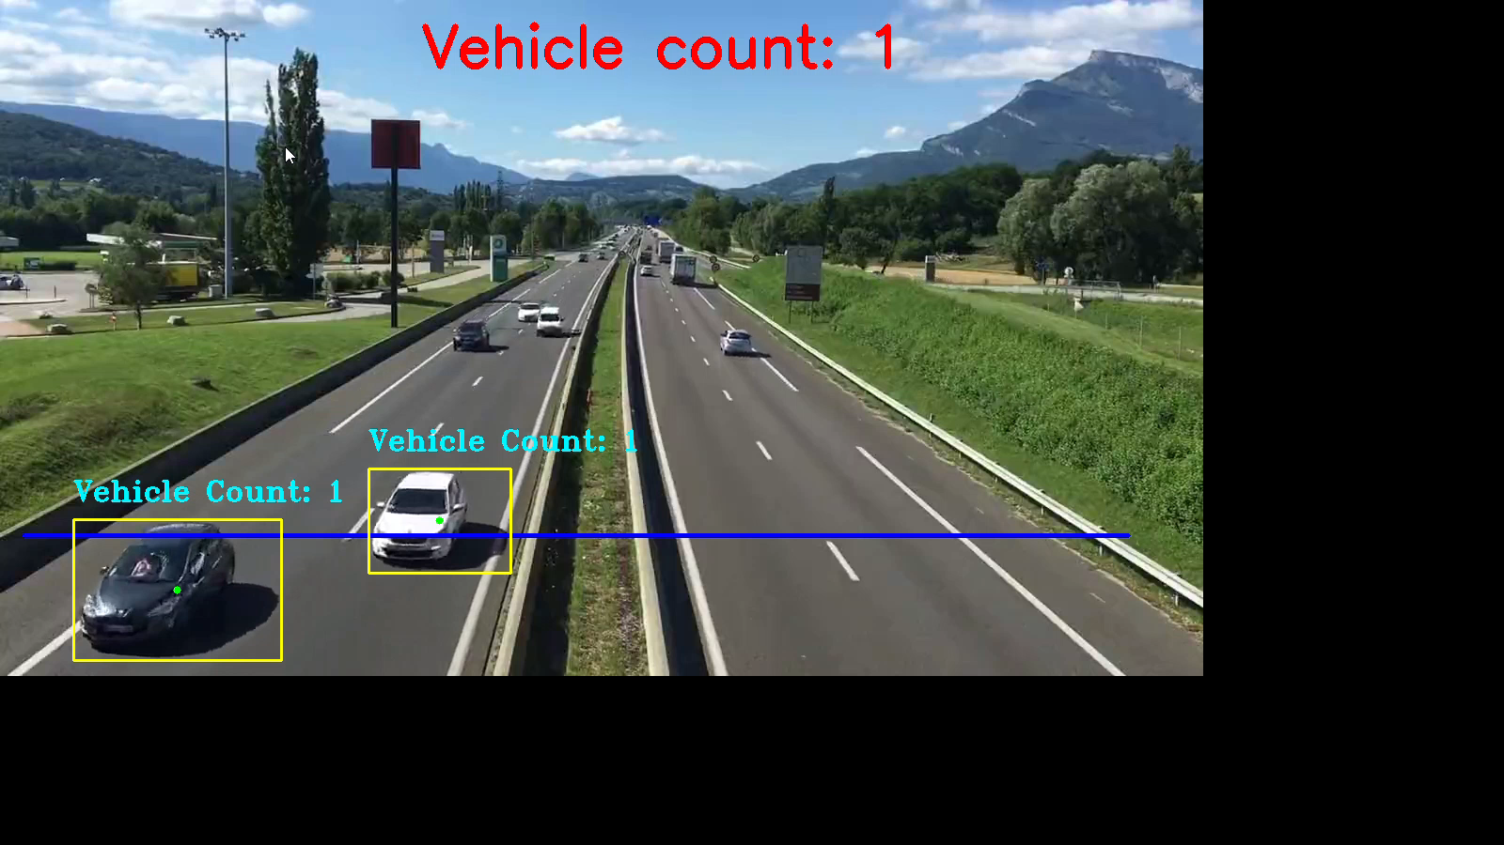
RESULTS

Slide 12
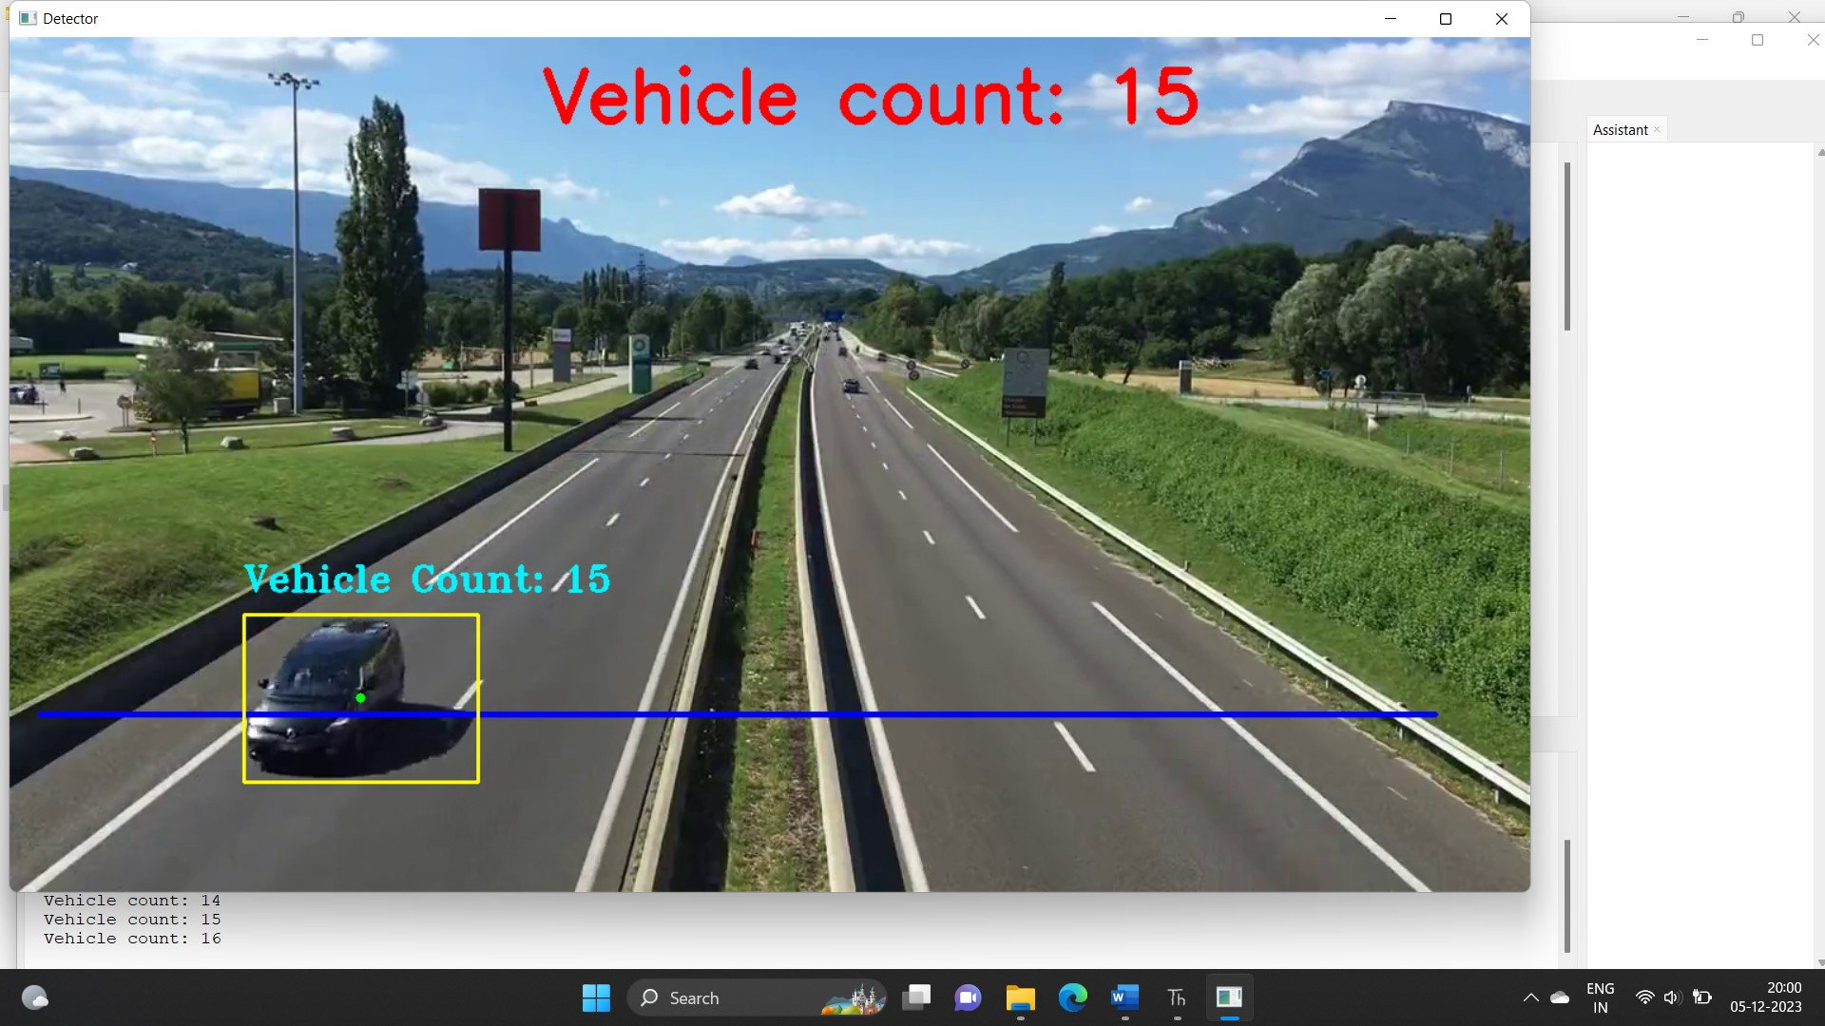
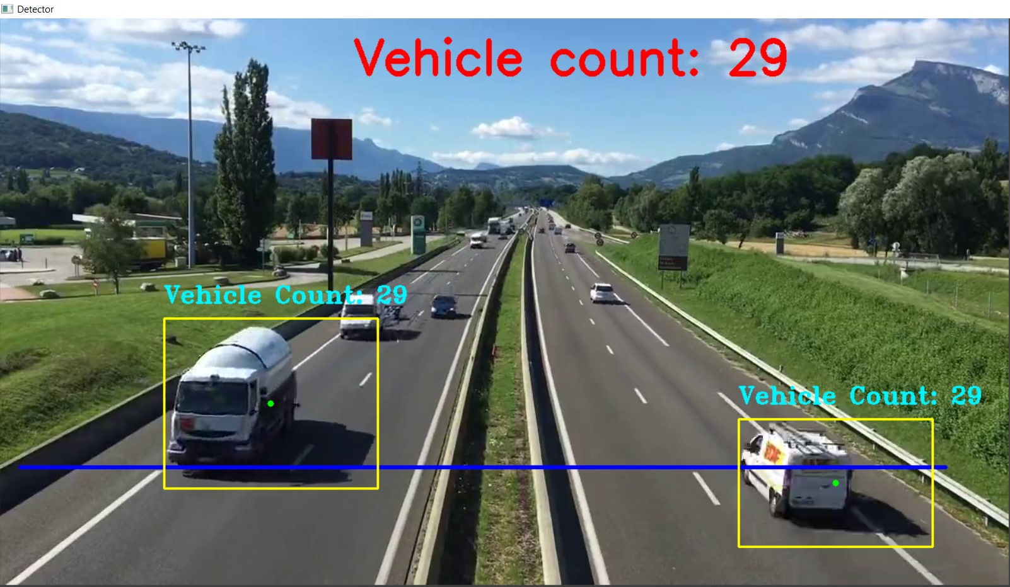

Slide 13
APPLICATIONS
Traffic management and planning: A vehicle detection and counting system could be beneficial for the traffic police because everything they can monitor from one place like how many vehicles have crossed this toll and which vehicle.
Maintaining records: It is challenging for some individuals to record all the vehicles with them because the vehicles are passing by in real-time, this application can be very well-versed to attain the time-saving quality and be automated.
Traffic surveillance control: As this application can be planted anywhere as it only requires a camera or some wires (for establishing the connectivity with the central system) hence if the traffic is high at someplace, then from that area, an officer can monitor it and forward the information to next toll officer so that they could be prepared beforehand.

Slide 14
CONCLUSION
The vehicle traffic data from this application can be used to count and classify vehicles on busy routes. Once this application is used to gather the data of vehicle types. Open Source Computer Vision Library (OpenCV) and Python Programming language is used to implement the method developed. The system in this is to calculate the number of vehicles passing on the road. It was based on the detection of vehicles that cross a virtual line. Vehicle detection is the basis and premise for researches such as parking lot management, vehicle tracking, and vehicle license plate recognition.
With the development of basic sciences of artificial intelligence and visual computing theory, as well as the improvement of sensor technology and the continuous improvement of the cost performance of computers, vision-based vehicle detection and tracking technology will make future cars develop more intelligent and practical.

Slide 15
REFERENCES
“Vehicle detection” under the Journal of Theoretical and Applied Information Technology-vol97 2018 edition
Amit Ghosh, An Adaptive Video-based Vehicle Detection, Classification, Counting, and Speed-measurement System for Real-time Traffic Data Collection, 2019.
Journal of physics: Conference series—Vehicle detection:A Review by Boa Hong
https://www.academia.edu/40536380/Vehicle_Detection_Tracking_and_Counting

Slide 16
THANK YOU!!

